Slide 1

Chronicle: RISe
Team 4

Slide 2
Members
Work ASSignments
Tools, Library & resources
Game’s idea
Extend features
Problems & solutions

Slide 3
Members
LEADER
Nguyễn Minh Khôi
MEMBERS
Hoàng Trung Đức
Nguyễn Mạnh Khang
Hoàng Vân Anh
Nghiêm Văn Nghĩa

Slide 4
WORK ASSignments
Member
Nguyễn Minh Khôi | Game Engine
Hoàng Trung Đức | Characters
Nguyễn Mạnh Khang | Characters
Hoàng Vân Anh | Scripting
Nghiêm Văn Nghĩa | Scripting

Slide 5



Tools, Library & resources

Slide 6
Game’s idea
Name
Category
Gameplay & Rules
LevelS

Slide 7
Game’s idea
Name
Gameplay & Rules
Levels
Category
CHRONICLE: RISE

Slide 8
Game’s idea
Name
Gameplay & Rules
Levels
Category
RPG
Fighting
Dungeon Crawler
Real-time

Slide 9
Game’s idea
Name
Gameplay & Rules
Levels
Category
Chơi theo cốt truyện
Đánh quái vật, thu thập vật phẩm qua màn
Mở khóa trang bị, bùa phép tăng sức mạnh

Slide 10
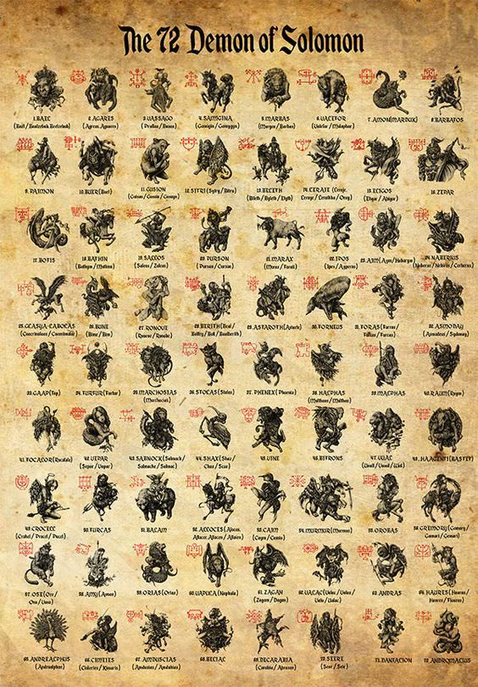
Game’s idea
Name
Gameplay & Rules
Levels
Category
Chơi theo cốt truyện
Đánh quái vật, thu thập vật phẩm qua màn
Mở khóa trang bị, bùa phép tăng sức mạnh

Slide 11

Game’s idea
Name
Gameplay & Rules
Levels
Category
Chơi theo cốt truyện
Đánh quái vật, thu thập vật phẩm qua màn
Jorvus
Mở khóa trang bị, bùa phép tăng sức mạnh

Slide 12
Game’s idea
Name
Gameplay & Rules
Levels
Category
Chơi theo cốt truyện
Đánh quái vật, thu thập vật phẩm qua màn
Jorvus
Skeleton
Mở khóa trang bị, bùa phép tăng sức mạnh

Slide 13

Game’s idea
Name
Gameplay & Rules
Levels
Category
Chơi theo cốt truyện
Đánh quái vật, thu thập vật phẩm qua màn
Jorvus
Hank
Mở khóa trang bị, bùa phép tăng sức mạnh

Slide 14

Game’s idea
Name
Gameplay & Rules
Levels
Category
Chơi theo cốt truyện
Đánh quái vật, thu thập vật phẩm qua màn
Jorvus
Stolos
Mở khóa trang bị, bùa phép tăng sức mạnh

Slide 15

Game’s idea
Name
Gameplay & Rules
Levels
Category
Chơi theo cốt truyện
Đánh quái vật, thu thập vật phẩm qua màn
Mở khóa trang bị, bùa phép tăng sức mạnh
Dark Diamond

Slide 16


Game’s idea
Name
Gameplay & Rules
Levels
Category
Chơi theo cốt truyện
Đánh quái vật, thu thập vật phẩm qua màn
Mở khóa trang bị, bùa phép tăng sức mạnh
Dark Diamond

Slide 17
Game’s idea
Name
Gameplay & Rules
Levels
Category
1. Ngôi làng
2. Rừng rậm
3. Cổng hầm ngục
4. Hầm ngục cuối

Slide 18
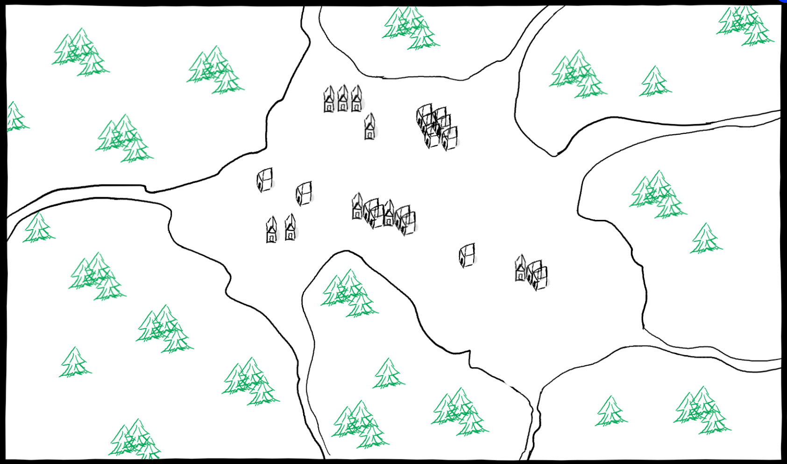
Game’s idea
Name
Gameplay & Rules
Levels
Category
1. Ngôi làng
2. Rừng rậm
3. Cổng hầm ngục
4. Hầm ngục cuối

Slide 19
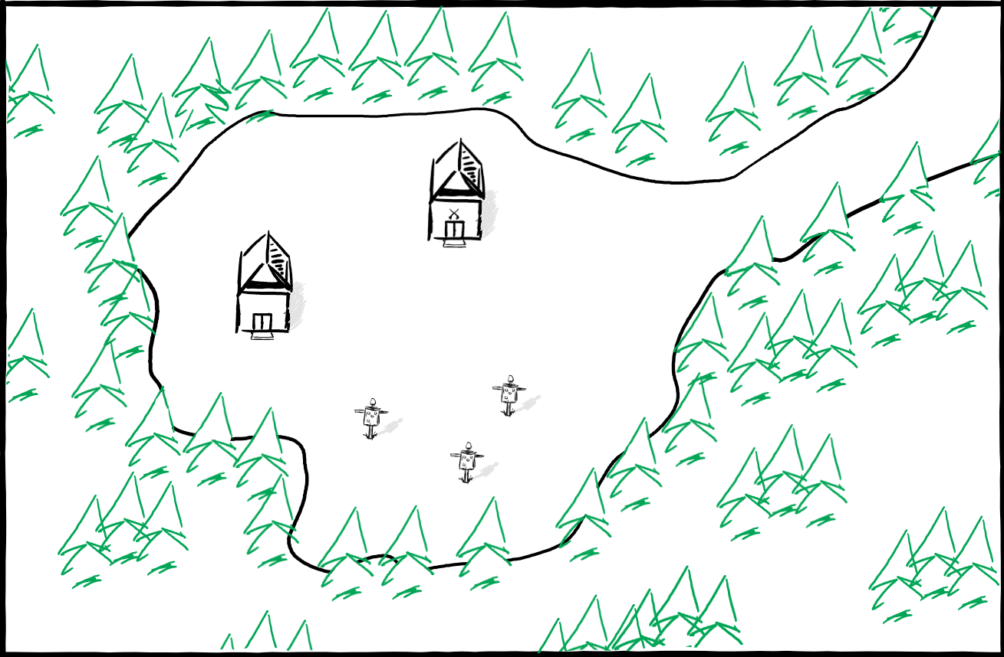
Game’s idea
Name
Gameplay & Rules
Levels
Category
1. Ngôi làng
2. Rừng rậm
3. Cổng hầm ngục
4. Hầm ngục cuối

Slide 20
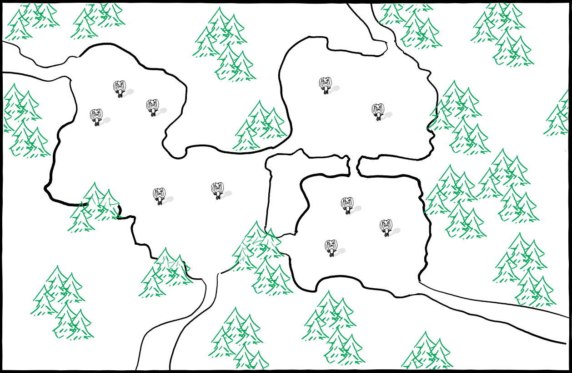
Game’s idea
Name
Gameplay & Rules
Levels
Category
1. Ngôi làng
2. Rừng rậm
3. Cổng hầm ngục
4. Hầm ngục cuối

Slide 21
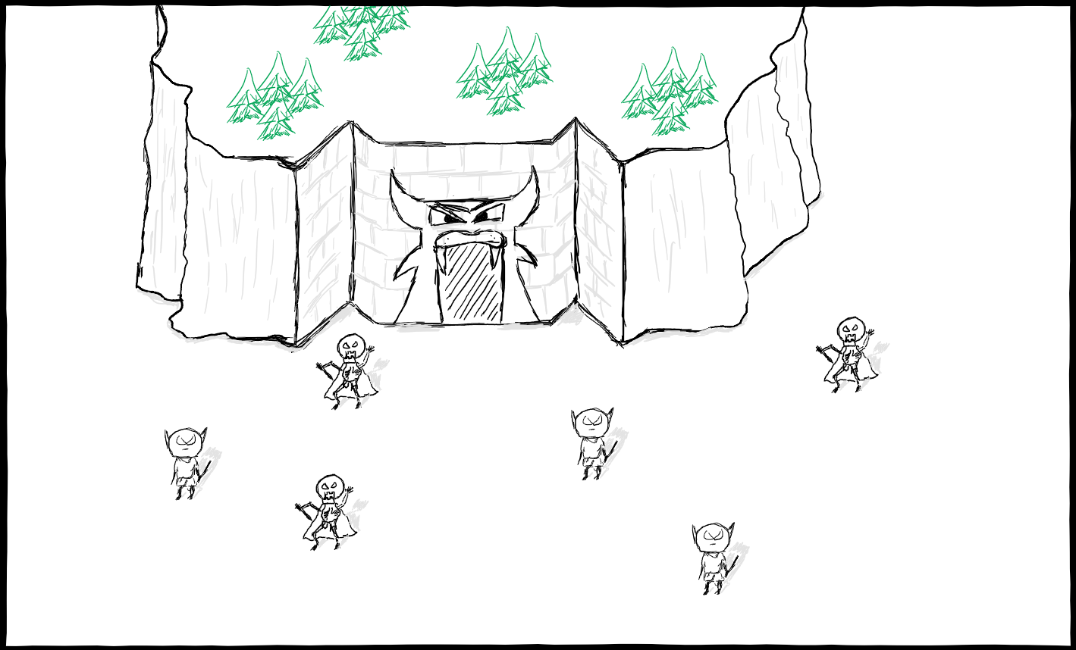
Game’s idea
Name
Gameplay & Rules
Levels
Category
1. Ngôi làng
2. Rừng rậm
3. Cổng hầm ngục
4. Hầm ngục cuối

Slide 22
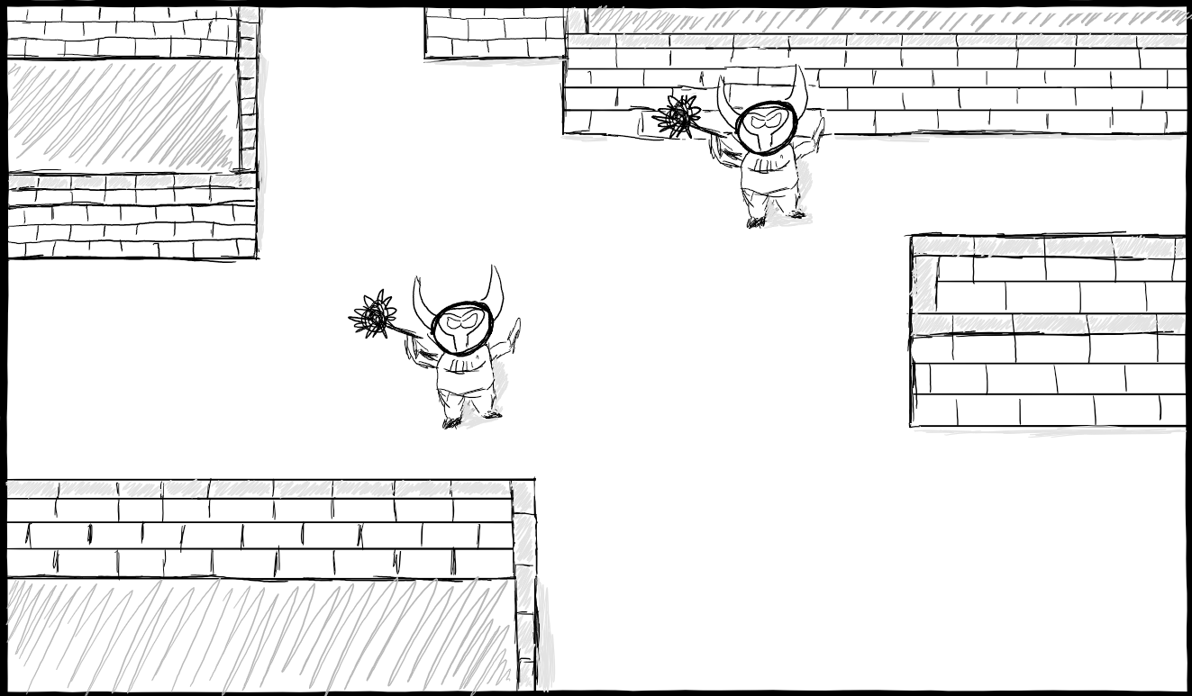
Game’s idea
Name
Gameplay & Rules
Levels
Category
1. Ngôi làng
2. Rừng rậm
3. Cổng hầm ngục
4. Hầm ngục cuối

Slide 23









